Slide 1
Client Consultations:
Barra and Factset Integration
June 6, 2005

Slide 2
Goals of This Client Research Project on Factset
Provide unbiased critical information to understand if and how to integrate Barra with Factset to best satisfy client needs. To do this we will:
  Clearly define the market segment (firms, users, use cases) we will target with a Factset/Barra solution
  Research, understand and confirm the client needs driving the desire for the often heard “Barra on Factset” request
  Develop & test proposed Factset/Barra integrated solutions that best satisfy client needs
  Verify that our proposed solutions align with the IT technology environment of our clients

Slide 3
Key Assumptions
Factset is only a proxy for data integrators
Focus here is on client needs – not on how to execute on them
This is only the first step in client understanding – more is needed

Slide 4
Who did we consult with – which segment?
Factset asset manager firms, based in the US and Europe, who also use risk models from Barra, APT or Northfield to manage equity-only portfolios
Rationale:
These clients will be best equipped to;
  describe the trade-off between “best of breed” analytics and data integration
  help us refine our understanding of Barra defection risk due to the absence of data integration in our current product suite
  help us prioritize the analytics capabilities that need to be supported in Factset
  validate our proposals of appropriate technology platform

Slide 5
Client Research Strategy
Client interviews started with open-ended questions about needs, their investment process, priorities, usage of products.. Most comments unprompted.
3 Product concepts were tested as follows:
  Concept 1 - Factset + Barra risk models
  Concept 2 - Factset + Barra risk models & analytics
  Concept 3 - Factset + Aegis (with automatic data replication into Aegis)

Slide 6
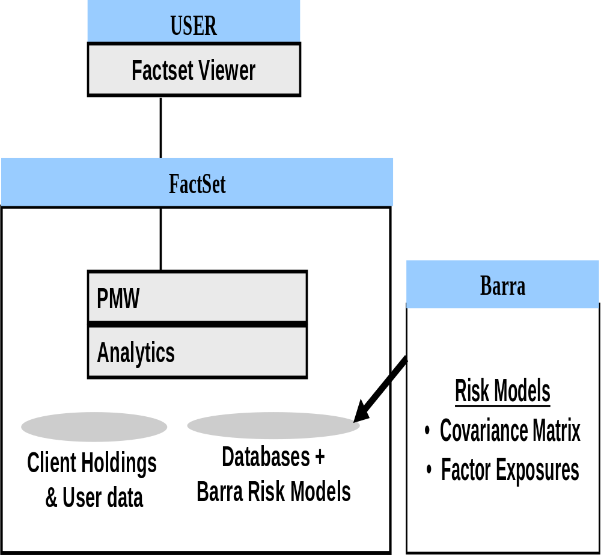
Product Concept 1: Barra Models on Factset
Proposed Product Concept
Barra risk models available on Factset
Analytics are from Factset, e.g. tracking error calculation and marginal contribution to risk are (calculated by Factset)
Proposed Benefits
Portfolio uploads only performed once by Factset
No Barralink downloads
Easy to integrate risk into Factset-oriented reporting or portfolio construction processes
Potential Considerations
Some analytics may produce different results than Aegis analytics
Workflow may differ from Aegis
Client service on models provided by Barra and analytics provided by Factset
Automation tools may differ from Aegis back-testing & reporting automation tools (AAA)
Any Aegis integration into workflow developed using ADT is not compatible

Slide 7
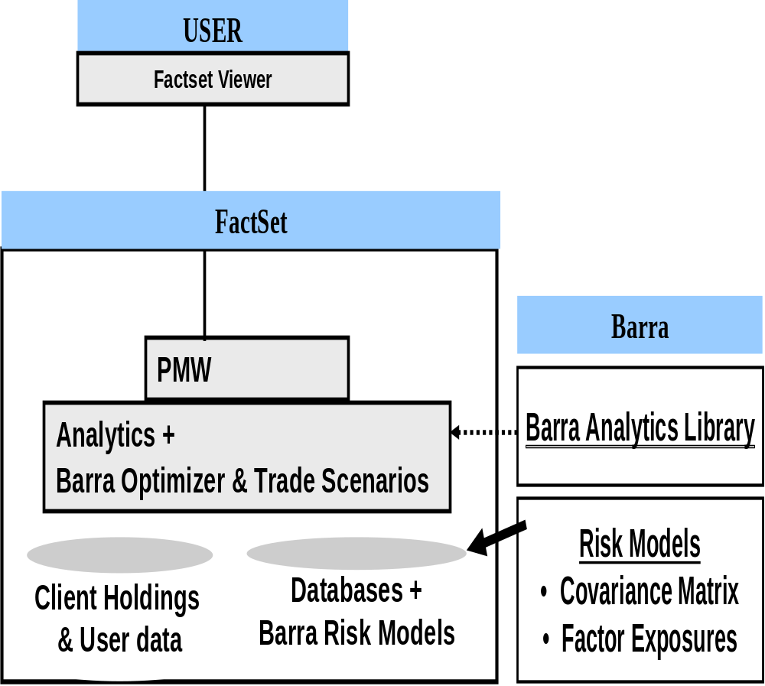
Product Concept 2:
Barra Models and Analytics on Factset
Proposed Product Concept
Barra risk models available on Factset
Barra optimizer & trade scenarios also available. Other analytics by Factset as in product concept 1 e.g. tracking error calculation and marginal contribution to risk are (calculated by Factset)
Proposed Benefits
Familiarity and confidence in the Barra optimizer & trade scenario analytics
Easy to integrate risk into Factset-oriented reporting or portfolio construction processes with a familiar Factset interface
Potential Considerations
Some analytics may produce different results than Aegis analytics. Factor attribution likely to be different
Workflow may differ from Aegis
Client service on Barra models, optimizer & trades scenarios provided by Barra. Other analytics service provided by Factset
Automation tools may differ from Aegis Automation Assistant for quant back-testing
ADT work with Aegis is not compatible

Slide 8
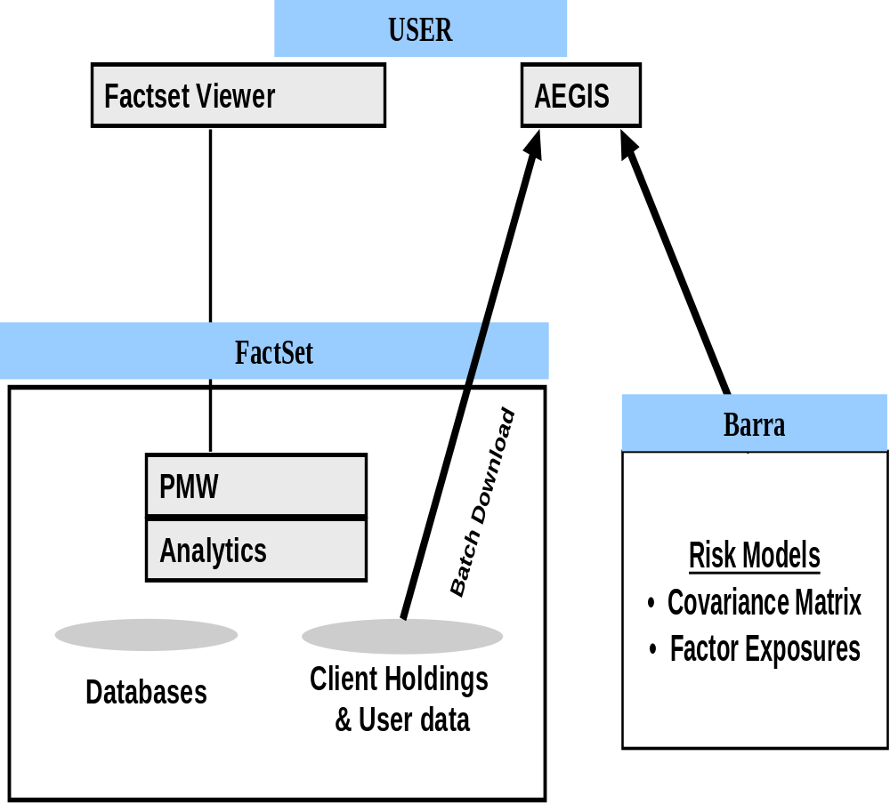
Product Concept 3 – Barra Aegis Integrates with Factset
Proposed Product Concept
Aegis and Factset sit side-by-side, with single source for portfolio holdings and user data
Aegis analytics and Factset analytics are identical to what is available in separate products.
Proposed Benefits
Familiar Aegis and Factset interface and workflow
  Full automated quant back-testing environment of Aegis
  ADT software investments will all continue to be utilized
  Identical factor attribution to what you use in Aegis today
Portfolio & data loading done once for both Aegis & Factset
Potential Considerations
Barra risk numbers not integrated into Factset-oriented reporting or portfolio construction processes via familiar Factset interface

Slide 9
Market Universe We Are Sampling
Current Prospects: Factset Analytics clients that could use Barra on FactSet now (estimated universe 350, globally)
  We consulted with 23
Future Prospects: FactSet clients w/o analytics packages today.
  We consulted with 7
Aegis Clients
23
4
FS Analytics clients
7
Factset Clients

Slide 10
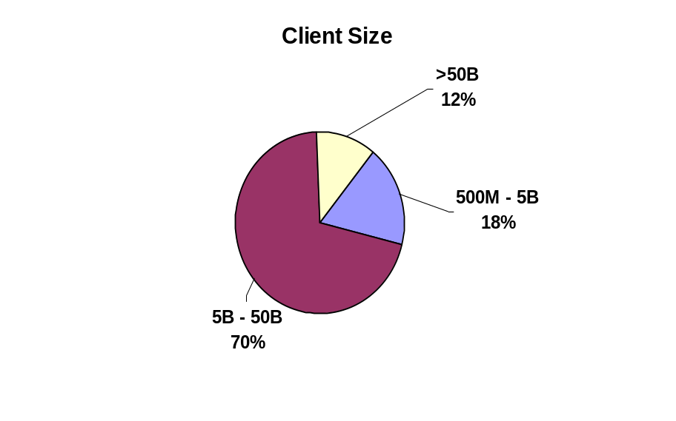
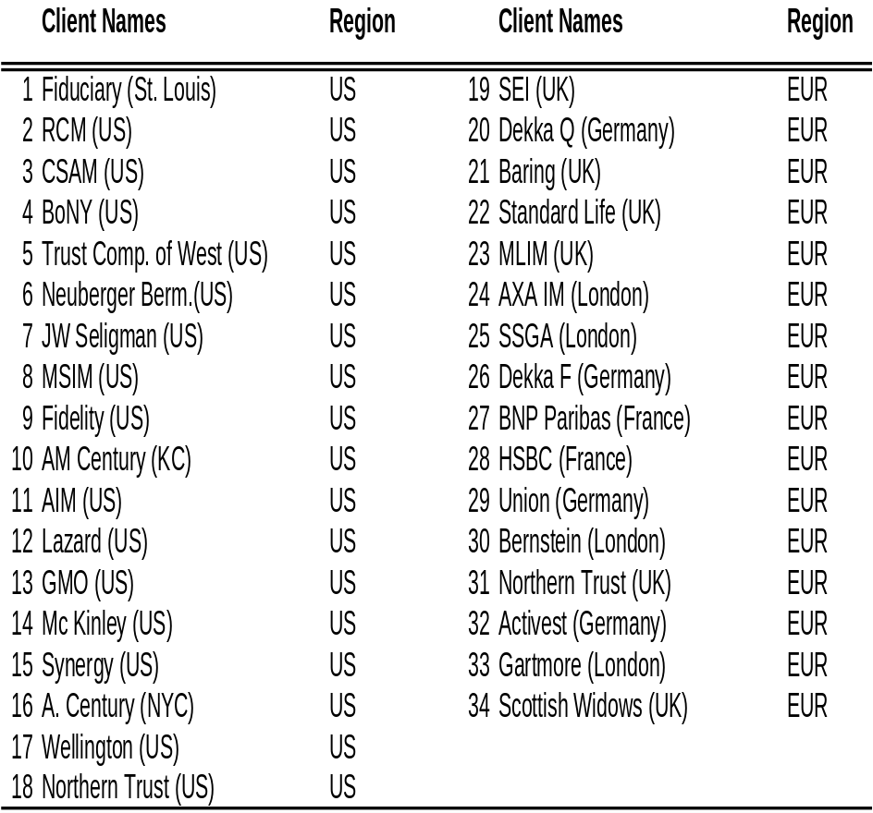
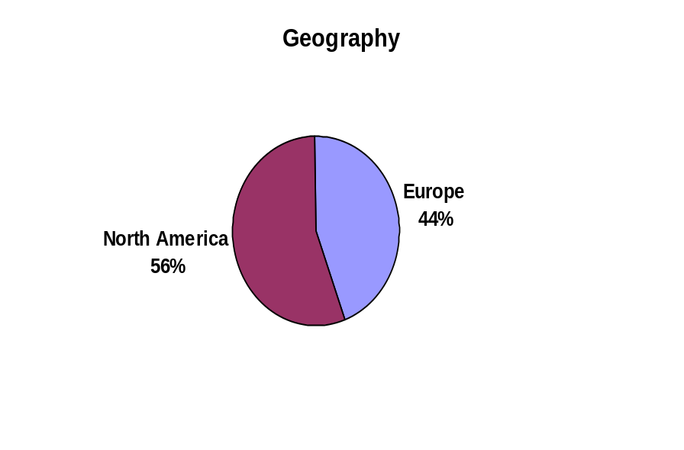
Who Did We Consult With?

Slide 11
User Types Represented in Sample
Generally, good representation for current Aegis users within FS firms
But some biases,
Fundamental PM teams (we don’t know the value they get from the risk numbers, nor from FS)
We miss Asian representation (but FS small in Asia)
We miss CEO/CIO representation
Quant analysts | Middle Office reporting | Quant PM | PM | Other
39% (19) | 33% (16) | 21% (10) | 4% (2) | 2% (1)

Slide 12
Use Cases Observed: Risk in the Investment Process
Risk Reporting/Monitoring
Report/monitor risk for all funds; often produce daily or monthly reports that get distributed internally and sometimes to clients
High volume, reliable processing is important
Play compliance/oversight role; independence from PMs is important
High Quant
Quantify views in terms of 'alpha'; alpha = expected return that is calculated from fundamental and market data
Investment process is highly dependent on analytics, e.g. optimizers (human judgment plays very small part)
Investment ideas are researched via back-testing that includes risk models and optimizers
Ad Hoc Risk Analysis
Quant Support role by helping PMs interpret risk information
Investment process is primarily fundamental -> high human involvement/judgment and high reliance on qualitative measures
Risk is small, but important, part of portfolio construction process.
Mostly used in conjunction with other information during decision-making process
Typically don't perform formal/rigorous back-testing because they don't quantify required inputs
Risk Use | Risk Reporting | High Quant | Ad Hoc Analysis
Count | 26 | 13 | 23
% of Clients | 86% | 43% | 77%

Slide 13
Findings & Conclusions

Slide 14
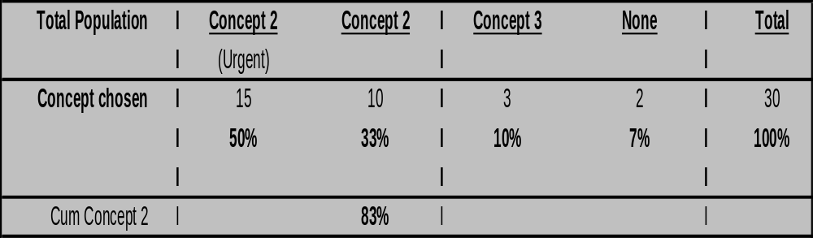
Most clients want Barra models/analytics on Factset
83% of the clients we met chose Concept 2 (Barra models and analytics on Factset). 50% want it “now”
No client wanted Concept 1 in the long term (just Barra models on Factset). Clients want Barra numbers. They don’t want to debate with consultants or clients.

Slide 15
Clients articulated concern about potential variances in Barra numbers
There is tolerance for some variance for internal use Barra numbers
There is no tolerance for variance in Barra numbers used externally
  “Barra is like a master setting that standardizes prices and all sorts of assumptions for all consultants. Internally, we could tolerate differences between Aegis and the FS solution. However, externally there is no place for ambiguity. Marketing is first“. McKinley
  “We want the Barra stamp on Analytics as we have to talk to Consultants”, American Century
MLIM in the UK (who likes Concept 2 + keep Aegis terminals), did not like Concept 1 because they “want to keep inter-dependence in their analysis”.
Implication: We need a 3rd party strategy for analytics that does not dilute our de-facto standard reputation and enables inter-dependent usage with the Aegis desktop

Slide 16
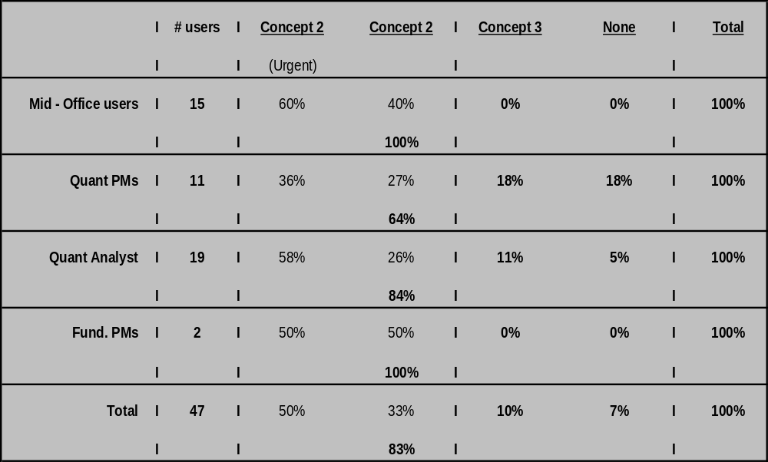
Who Chose what?
Concept 2 (Barra models and analytics on Factset) is a clear winner with all users, but particularly in the Middle Office and Quant analysts.
The appeal with Quant PMs is more balanced

Slide 17
Firms that have a fully integrated processes on Factset want Concept 2
There are 2 types of FS firms. Those with very integrated FS usage and those (all in Europe) mostly relying on FS for sourcing external data (e.g. Worldscope, IBES, MSCI)
77% of the firms we saw are “FS integrated” (*); e.g. MLIM, Dekka, all US clients
87% of the FS integrated firms want concept 2 (Barra models and analytics on FS). 65% want it “now”
Less FS integrated firms are more balanced. Less urgency for the FS integration
 | Total | Concept 2 (Urgent) | Concept 2 (Not Urgent) | Concept 3 | None
Firms using FS extensively (*) | 23 | 65% (15) | 22% (5) | 13% (3) | -
Other Firms | 7 | - | 71% (5) | - | 29% (2)
(*) proxy ~ load portfolios in FS and use PA

Slide 18
What is driving FS integrated firms to want Concept 2?
The drivers for FS integrated firms are Data Mgmt and the ability to Combine risk data with other forms of data and Ease of Reporting
  FS removes many data pain points, including reconciliation, extra data loads and timeliness of delivery
  Many clients expressed a desire to extend their Performance Attribution analysis done today on FS PA with some form of risk analysis
  Ability to automate and enhance reporting is also high, but not the most important driver
Among Firms using FS extensively (*) and wanting Concept 2 | Total | Easy Reporting | Data Mgmt. Issues | Combine Risk & Other Data
Count | 23 | 12 | 18 | 18
% of total |  | 52% | 78% | 78%
(*) proxy ~ load portfolios in FS and use PA

Slide 19
Selected quotes on key Barra/FS drivers
Data Management Issues (Timeliness & Accuracy)
Clients don’t want to waste their time on loading data in multiple systems, checking and reconciling data, etc.. Want to get out of data management business and spend their time on portfolio analysis.
  “Daily update downloads sucks – when it breaks, it is tough to figure out. 1 in 10 times, the data does not get there” Fidelity
  “We can’t manage a passive fund with monthly updates & too complicated to do daily loadings on Aegis”, Scottish Widow
Report Generation
Clients want to use their standard reporting tools – Excel, Crystal. They do exports from Factset or SQL queries into Excel or to a database for reporting. Interactive use and analysis with the Factset point and click interface and the “batcher” for report jobs
  “Reports need to be ready at 7:30am without fail” Fidelity
  “the ease of pulling data into Excel front-end is unbelievably powerful” CSAM, US
Combine Risk & Other data
PMs are more interested in characteristics/PA reports. They would be more interested if the risk numbers would be integrated in these, and in Performance Attribution reports run off FS
Clients want to analyse their portfolios seamlessly through various angles or slice data for analytical and marketing purposes.
  “PMs don’t like Aegis reports – they are too standardized. PMs want to combine elements of different reports into a summary” Fiduciary AM

Slide 20
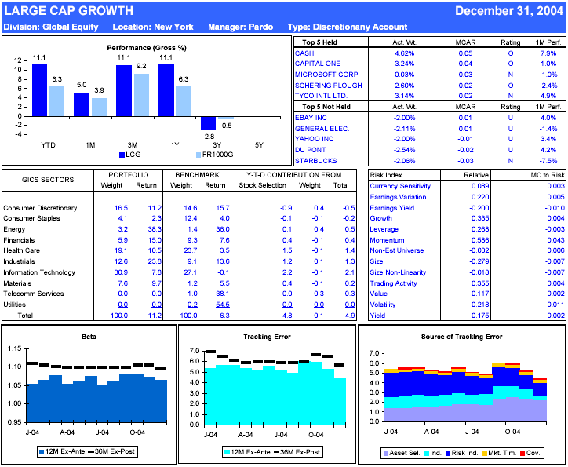
Combining Data - CSAM: “Top Down” Risk-Performance Report Example

Slide 21
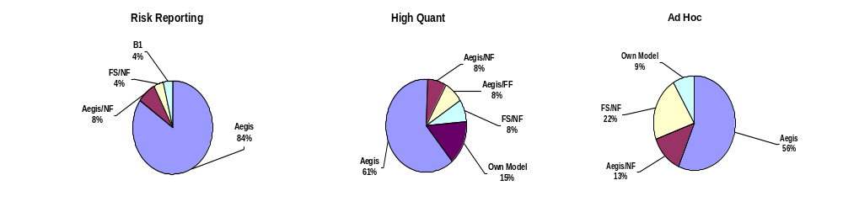
Among FS clients, Aegis looses ground in Ad Hoc Usage
Among FS clients;
Aegis is still the driving force for reporting (investor & consultant demand)
Aegis/Barra still holds a strong foothold in the High Quant usage (need to monitor the “own models”)
However, the NF/FS ease of use is driving more frequent usage in many of our clients
  Lazard “would never use Barra for new structured product”
  Standard life “takes me 2 minutes to do an analysis with NF/FS when it would take me 2 days with Aegis”
88%
69%
56%

Slide 22
Other Functionalities expected in Concept 2
“We would be very annoyed if you were to integrate in FS with a Mickey Mouse solution where you arbitrarily exclude functionalities just to force us to keep the Aegis terminal” SEI, London
Clients want to be able to replicate all their Aegis uses on FS
  All clients want standard Aegis reports (TE, Risk Decomp, Factor exposures, MC to risk, etc..)
  All clients that use OPS want it replicated on FS
  All clients that use APA want it replicated on FS
Many clients expect that their processes will be easy to automate on FS
  Want massive automation of processes on FS like AAA (Fidelity, Lazard)
We heard mixed signals regarding back testing
  Some users commented that Back Testing was primitive on FS, others said back testing was excellent. This needs further study.
“without FS we would not have been able to have daily reports to PMs every morning”, MLIM, London
“We dislike FS charging for everything, including batching. This makes Aegis AAA attractive because we can automate as many reports as we like”, Lazard AM, US
“The back testing on FS is woefully inadequate and they have been promising it for 3 years” McKinley Capital
“Back testing on FS with NF is excellent” Dekka

Slide 23
Stickiness of the Aegis Desktop in our Sample
 | Fairly certain to keep the Desktop | Uncertain | Will Drop
Top Line | 8 | 10 | 12
Use Aegis (Barra) in High Quant | 88% | 10% | 17%
Use Aegis (Barra) in reporting | 63% | 80% | 100%
Use Aegis (Barra) Ad Hoc | 88% | 20% | 58%
Back testing on Aegis | 50% | - | 25%
APA on Aegis | 63% | 10% | 33%
OPS on Aegis | 88% | 50% | 58%
Clients more certain to keep Aegis tend to:
Have a High Quant usage
Back test on Aegis
Tend to use Ops and APA more
Will do Ad Hoc analysis on Aegis
Client uncertain tend to;
Use Aegis more for reporting
Client more likely to drop Aegis
Expect a better solution on FS for reporting and for ad hoc analysis
CONCLUSION
Stickiness will depend a lot on whether Aegis can uniquely meet the High Quant usage and Back testing needs. Both can co-exist.
Keep the desktop = those that said they would, concept 3 and “none”
Uncertain = those that chose concept 2 but were uncertain whether they would keep Aegis

Slide 24
Drivers to Concept 3 (Factset & Aegis together)
High quant clients who are used to Aegis and need full quant functionality choose option 3 – (Am century NYC, Synergy.)
Cited as reasons to stay on Aegis for now:
  Uncertainty on what will and what will not be available on FS (e.g. APA) & lack of confidence that FS can deliver high quant capabilities (including quant back-testing)
  Uncertainty on price
  AAA automation used for full blown quant back-testing environment
  Monthly automated reporting already running, data loads not that bad
  Barra factor attribution (APA)

Slide 25
Other Important Findings: Brand Reputation
Signs of Brand Dilution & Risk Commoditization Appearing
Quite a few clients claimed not to see a difference between Barra and other models;
  Fidelity, AIM, Lazard, GMO, J.W.Seligman, BONY, RCM, Dekka, Baring, Union Invest
  “We believe the value of a risk model is commoditized for how we invest – bottom up with a top down look later at risk. We don’t see discernable differences from Northfield, except the cost with Aegis is higher”, JW Seligman
Many clients perceive a Barra model superiority;
  MLIM, Fiduciary, McKinley, MSIM, BONY, Baring, RCM
  “we trust Barra Analytics and are paying for Barra research”, Fiduciary

Slide 26
Going Forward; preliminary thoughts
Based on this consultation, we should proceed with the integration of Barra models/analytics around Concept 2
Aegis plan
  how much resources put behind fixing data management pain points vs. driving more High Quant functionalities?
  More client consultations needed to pinpoint High Quant needs (current and un-met)
Content plan
  Articulate specific analytics that will be replicated on FS. Work with FS and then validate details with clients again.
  Pricing plan. How much will pricing be driven by client acceptance vs. revenue maximization?
  More consultations needed to understand where and how to expand Barra usage in the integrated FS environment.
Firm Plan
  What do we do if another “aggregator” asked for a similar integration? Should we be pro-active?

Slide 27
Appendix

Slide 28
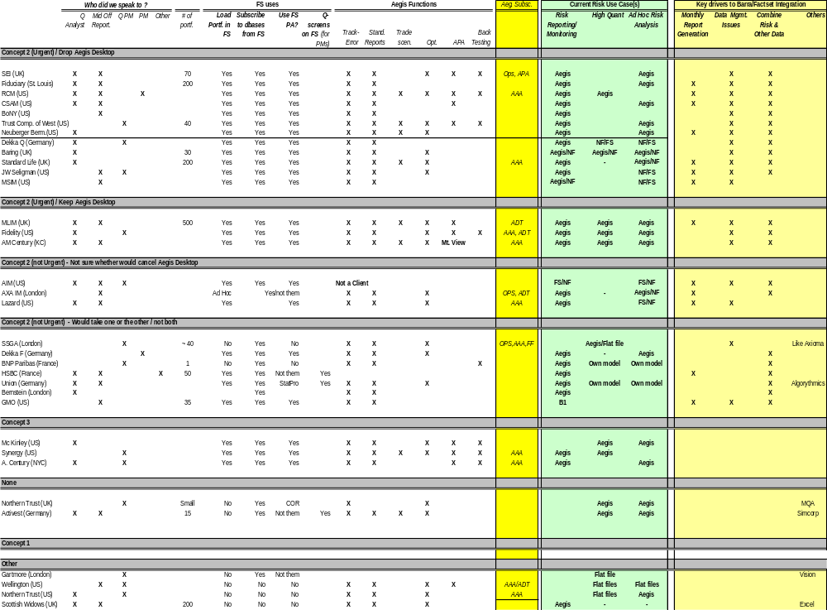

Slide 29
Strategic Hypothesis: Barra Use May Spread
Strategic Hypothesis: Barra use may spread more widely in organizations on Factset
Reasons:
It is a tool being accepted more widely in organizations, it is easy to use and its use is growing.
More portfolio holdings are available on Factset to analyze vs. the subset that are loaded in Aegis for risk analysis – e.g. TCW loads 40 into Aegis but has 1000 portfolios on Factset
Risk can be combined with more data that it can be today in Aegis alone. Numerous clients stated they believed marketing and PMs would start making more use of this data. (GMO, Fiduciary, CSAM, MSIM, Synergy, AIM)
FS use is pushed in the organization because of the lack of incremental IT support needed for new uses.

